Slide 1
GBASE
an efficient analysis platform for large graphs
Notes:
How to store graphs efficiently? How to answer the graph queries quickly?

Slide 2
Novelties
Storage and compression scheme for a parallel, distributed settings
Graph operations and their efficient implementations
Notes:
Designed and implemented an instance of GBASE using MAPREDUCE/HADOOP.
GBASE provides a parallel indexing mechanism for graph operations that both saves storage space & accelerates query responses.

Slide 3
Problem definitions
Storage
Algorithms
Query Optimization
Major challenge: Scalability
Notes:
ANY many-to-many database relationship can be easily treated as a graph.
GOAL: build a general graph management system in parallel, distributed settings to support billion-scale graphs for various applications.
Large graph cannot be fit in main memory or at least the disk of a single workstation.

Slide 4
Contributions
Storage - Compressed Block Encoding
Algorithms
Query optimization - minimize disk accesses, answer queries quickly, MAPREDUCE algorithm
Notes:
compressed block encoding - efficiently store homogeneous regions of graphs based on adjacency matrix representation.
algorithms - formulating edge-based queries and node-based queries using a unified framework
MapReduce - support incidence matrix-based queries using the original adjacency matrix. without explicitly building the incidence matrix.

Slide 5
Structure
Overall framework
Graph storage and indexing
Handling graph queries
Experiments

Slide 6
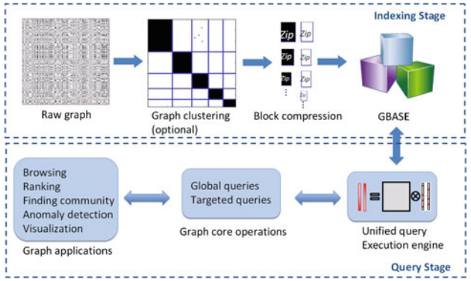
Overall framework
Notes:
Indexing Stage: raw graph is clustered and divided into compressed blocks.
Query Stage: global and targeted queries from various graph applications are handled by a unified query execution engine.

Slide 7
Indexing stage
Partitions the raw graph into several homogeneous blocks.
Reshuffles the nodes so that the nodes belonging to the same partition are put nearby.
Compresses all non-empty blocks through standard compression algorithms.
Store the compressed blocks and some meta information into the graph databases.

Slide 8
Query stage
Query execution engine - Unifies the different types of inputs as query vectors.
Provide a set of core operations that will be sufficient to support a diverse set of graph applications.
Support multiple different types of queries simultaneously.

Slide 9
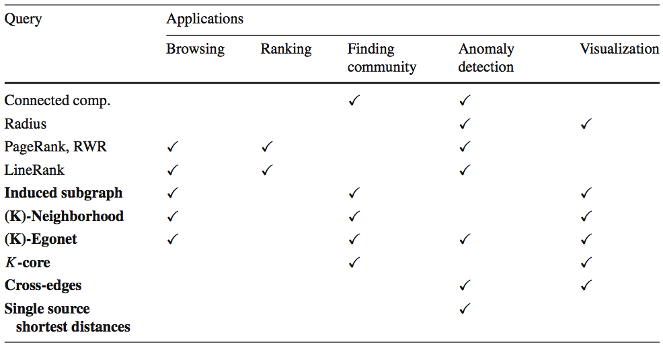
Notes:
Queries supported by GBASE.
These queries construct the main building blocks for a variety of important graph applications.

Slide 10
Structure
Overall framework
Graph storage and indexing
Handling graph queries
Experiments

Slide 11
Baseline storage scheme
Typical way
Adjacency list format: for each node, it saves all the out-neighbors adjacent from the node.
GBASE
Sparse adjacency matrix format: save each edge by a (source, destination) pair.
Notes:
Typical way: simple and might be good for answering out-neighbour queries. Not an efficient format for answering general queries including in-neighbour queries and ego-net queries.
Gbase: Only store nonzero elements of a matrix and does not store empty elements. Advantage: Its generality and flexibility to enable efficient storage and indexing techniques.

Slide 12
Block formulation
Graph partition - re-order rows and columns, and make homogeneous regions into blocks.
Any partition algorithm can be naturally plugged into GBASE.

Slide 13
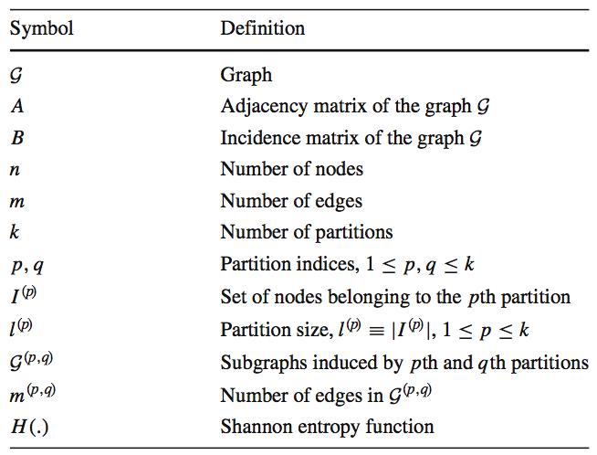

Slide 14
Graph Partition
Storage Objective - find the optimal k partitions which lead to smallest total storage cost of all blocks/subgraphs G(p,q) where 1<= p, q <=k.
Make the induced subgraphs to be homogeneous, which captures community structure and leads to small storage cost.
Notes:
Homogeneous: subgraphs are either very dense or very sparse.
Example: a graph has two cliques connected by an edge can be partitioned into two groups. Each group contains all the nodes in a clique.

Slide 15
Block compression
Encode the graph in a more efficient way.
The encoding of a block G(p,q):
source and destination partition ID p and q;
the set of sources I(p) and the set of destinations I(q);
the payload, the bit string of block G(p,q).

Slide 16
Encoding block
Naive way - raw block encoding
Only stores the coordinates of the nonzero entries in the block.
GBASE - compressed block encoding
Converts the adjacency matrix of the subgraph into a binary string and stores the compressed string as the payload.
Notes:
Any optimal compression algorithm can be used for the compressed block encoding.
Compressed block encoding:
Con: requires more cpu time to compress and uncompress blocks.
Pro: storage savings and the reduced data transfer size help to improve performance of GBASE.

Slide 17
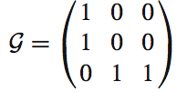
Zip Compression
Naive way - Store (0,0), (1,0), (2,1), and (2,2) as payload
GBASE - Use zip algorithm converts the matrix into a binary string 110, 001, 001 and then run the Gzip algorithm to generate the payload.

Slide 18
Gap Elias-gamma Encoding
Compute the gaps between nonzero elements inside a block
Compress the gaps using Elias-gamma encoding to create the payload
Elias-gamma encoding stores a number x using bits which is close to the information-theoretic minimum.
Notes:
(0, 1, 4, 3)

Slide 19
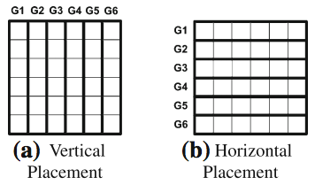
Block placement
Typical approach
use vertical placement to place the vertical blocks in a file.
use horizontal placement to place horizontal blocks in a file.
only good for one type of query, out-neighbor and in-neighbor queries respectively.
need O(K) file accesses.
Notes:
Main idea - place several blocks together into a file, and select only relevant files as inputs in the query stage.
Need O(K) file accesses to find the out- and in-neighbors of a given query node, respectively.

Slide 20
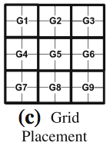

GBASE
Grid Placement - efficient for queries that access in-neighbor, out-neighbor, or both.
Minimizes the number of input files to answer queries.
Only need files accesses.

Slide 21
Structure
Overall framework
Graph storage and indexing
Handling graph queries
Experiments

Slide 22
Global queries
Performed by repeated joins of edge blocks and vector blocks
Main Contribution
Proposed storage and compression scheme reduce the graph storage significantly
enable faster running time
Notes:
The answer to global queries requires traversal of the whole graph.
Targeted queries need to access only parts of the graph.
Gbase supports eleven different queries.

Slide 23
Targeted queries
Matrix-vector Multiplication
the adjacency matrix A of size n*n
the incidence matrix B of size m*n
The matrix-vector multiplication observation corresponds to a SQL join
Notes:
n and m are the number of nodes and edges in the graph, respectively.
incidence matrix: Each row of the incidence matrix corresponds to an edge, and it has two nonzeros whose column ids are the node ids of the edge.

Slide 24


T1: 1-step neighbors
Find 1-step in-neighbors & out-neighbors of a query node v.
Matrix-Vector version
1-step in-neighbors:
1-step out-neighbors can be obtained in the similar way by replacing A with its transpose
Notes:
First query - Find 1-step in-neighbors and out-neighbors of a query node v
A - the adjacency matrix of the graph
ev - the indicator vector which is the n-vector whose vth elements is 1, and all other elements are 0s.
1-step in-neighbors of v are those nodes with values in in1(v) are 1s

Slide 25

T1: 1-step neighbors
SQL version
1-step out-neighbors of a query node “q”:
Switch src and dst to get in-neighbors

Slide 26

T2: K-step neighbors
Find “within k-step” neighbors.
Matrix-Vector version
k-step in-neighbors of the query node v is defined recursively by (k-1)-step neighbors:
0-step in-neighbors is simply the indicator vector ev
Notes:
After k multiplications, the k-step in-neighbors are those nodes whose corresponding values in nhk(v) or nh(k-1)(v) are 1s.

Slide 27
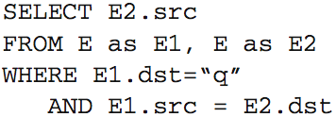
T2: K-step neighbors
SQL version

Slide 28

T3: Induced subgraph
Matrix-Vector version
Let B be the m*n incidence matrix
Let evq be the n-vector, whose corresponding elements for Vq are 1s and 0s otherwise
Induced subgraph from Vq is:
Edges with corresponding values 2s means
the incident nodes of the edges are in Vq
Notes:
induced subgraph - Given a set of nodes Vq in a graph G, A graph whose nodes are Vq and an edge between two nodes v1 and v2 exist if and only if they are adjacent in G.
m is the number of edges of graph
n is the number of nodes of graph
The resulting vector S(Vq) is m-vector and the elements in S(Vq) have values of 0,1, or 2.

Slide 29
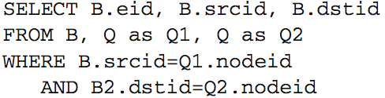
T3: Induced subgraph
SQL version
Incidence matrix table B(eid, srcid, dstid)
Query vector table Q(nodeid)
Notes:
eid, srcid, dstid - represents the edge id the source node id, and the destinations id of a row in the incident matrix, respectively.

Slide 30
T4: 1-step egonet
Defined as the induced subgraph that includes v and its 1-step neighbors.
Extracting the egonet of a query node v is a special case of extracting induced subgraph.
Vq - the v and its 1-step in-neighbors and out-neighbors.

Slide 31
T5: K-step egonet
Defined as the induced subgraph from v and its within-k-step neighbors.
Extracting the k-step egonet of a query node v is also a special case of extracting induced subgraph.
Vq - the v and its within-k-step neighbors.

Slide 32
T6: K-core
A maximal connected subgraph in which all vertices have degree at least K.
Compute degrees of all nodes. Let C be the set of nodes with degree >= K
Compute induced subgraph G` using C
Find connected components of G`. The resulting components are the K-core
Notes:
K-core can be computed by GBASE using induced subgraph

Slide 33
T7: Cross-edges
Given two disjoint sets V1 and V2 of nodes
Computed induced subgraphs S(V1), S(V2), S(V1UV2) using nodes in V1, V2, and (V1UV2),respectively
Let E1, E2, and E12 be the set of edges in S(V1), S(V2), and S(V1UV2), respectively. The cross-edges are the edges in E12-E1-E2
Notes:
Cross-edge can be computed by GBASE using induced subgraph queries

Slide 34



T8: Single-source shortest distances
The single-source shortest distances query finds the shortest path distances from q to the nodes reachable within k steps.
Matrix-Vector version
Initialize d0 by setting 0 for the element q, and for other elements.
=>
Notes:
dk is updated recursively from dk-1

Slide 35
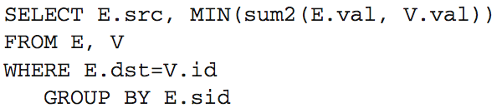
T8: Single-source shortest distances
SQL version
Table E(src, dst, val)
Table V(id, val)
The next-step distance vector is:
Notes:
table E - source node id, destination node id, and weight of edge
table V - row id, the value of the element at row

Slide 36
Query execution engine
The query execution engine of GBASE is built on the top of HADOOP
Grid selection
Before matrix-vector multiplication, GBASE selects the grids containing the blocks relevant to the queries.
Global queries: select all the grids.
Targeted queries: select only relevant grids
Notes:
The main operation of GBASE is the matrix-vector multiplication.
Most of the operations require the adjacency matrix of the graph.
How to handle the queries requiring incidence matrix efficiently?

Slide 37
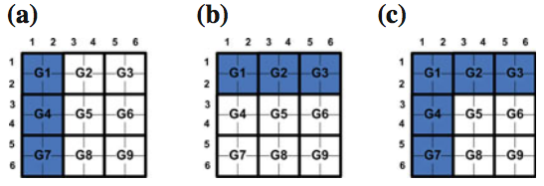
Grid selection
(a) in-neighbor queries
(b) out-neighbor queries
(c) in/out neighbor and egonet queries

Slide 38
Query execution engine
Handling induced subgraph queries
Naive way - build the incidence matrix by numbering edges sequentially
Problem: requires the storage to save B which is twice the size of the original adjacency matrix
Notes:
The induced subgraph queries use the incidence matrix

Slide 39
Handling incidence matrix queries
GBASE - derive the incidence matrix from the original adjacency matrix as required
Interpret (src,dst) as ([src,dst],src) and ([src,dst],dst)
treat each adjacency matrix element as two incidence matrix elements

Slide 40

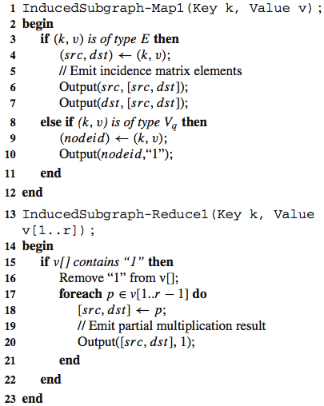
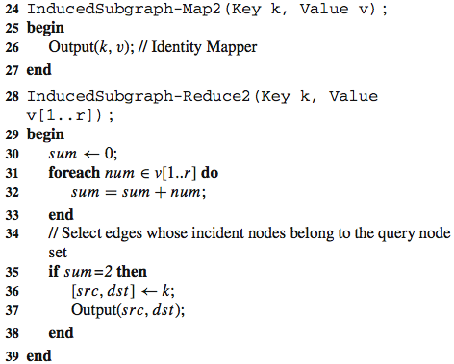
HADOOP algorithm

Slide 41
Structure
Overall framework
Graph storage and indexing
Handling graph queries
Experiments

